Slide 1
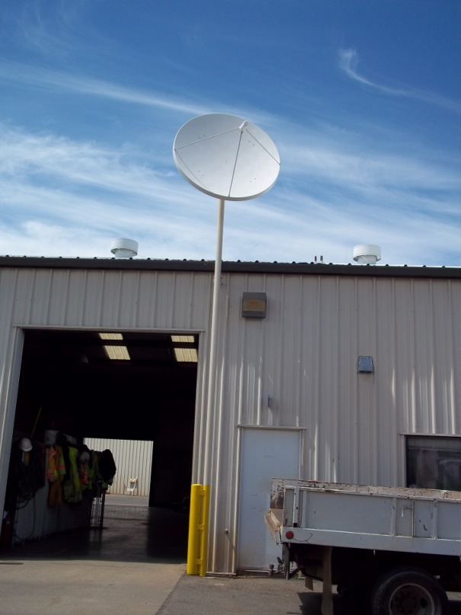
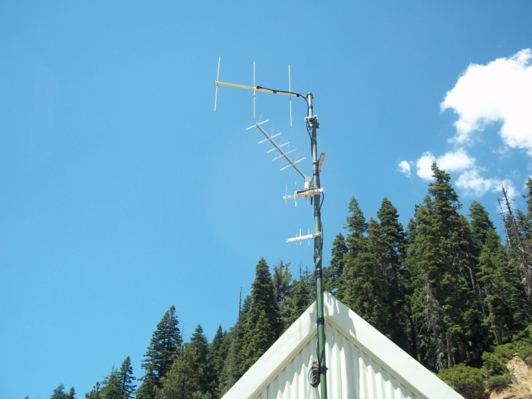
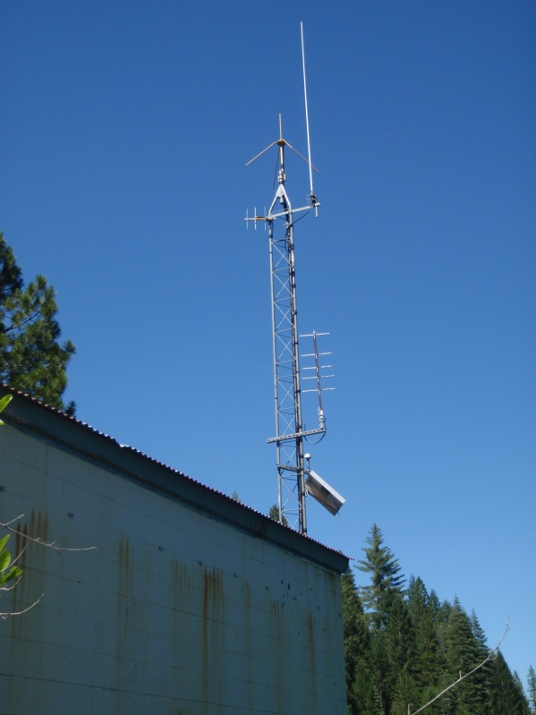


HP-II Workshop on Real-time Hydrological Information Systems
Module 2 - Part 2:
Current Real-Time HIS Telemetry Solutions
Mark Heggli, Meteorologist/Hydrologist
Expert Real-time Hydrology Information Systems
Innovative Hydrology, Inc.
Consultant to the World Bank

Slide 2
Examples that refer to products are intended for illustrative purposes only, and do not imply an endorsement or recommendation of any particular product

Slide 3
Overview
Types
  Terrestrial-based solutions
    ALERT Radio
    Interrogated radio
    GSM/ GPRS
  METEOBURST
  Satellite-based solutions
    ORBCOMM
    Iridium
    INMARSAT
    INSAT
    VSAT

Slide 4
Terrestrial-based solutions: ALERT Radio
Concept
  ALERT radio is a one way radio communication system where the remote station reports data in real-time
  Programmed to transmit sensor readings based on changes in sensor measurements exceeding programmed limits
    Example:
      Transmit data every 1 mm of precipitation
      And/or if the water level rises .2 m in 15 minutes
      Whatever conditions the operator would like to program

Slide 5
ALERT Radio General Information
ALERT protocol is an open standard
  Which means numerous vendors are able to provide equipment and software
The ALERT system is primarily used for flood warning, and is usually bundled with decision support software to help in making decisive action
  Adaptation has been made to use in mountainous terrain with the addition of mountain-top repeaters.
Transmission:
  VHF frequencies, usually being less than 180 MHz.
  VHF frequencies are desirable because the signal can be transmitted and received without being line-of-sight.
Regulation:
  Requires approval of radio frequency use from the Telecom Regulatory Authority of India
  More on ALERT radio systems and ALERT system suppliers can be found at http://www.alertsystems.org/.

Slide 6
Advantages/Disadvantages to ALERT Radio
Advantages
  There are numerous suppliers of ALERT transmitters and the ALERT DSS is very advanced
  The radio frequencies are not shared with the public so there is no concern for incidental interference
  Data sharing is much easier with ALERT than it is with the Interrogated Radio
  Very low latency
Disadvantages
  One way communication (sufficient for hydrometric measurement but not control systems (SCADA)
  High cost for radio frequency licensing in India

Slide 7



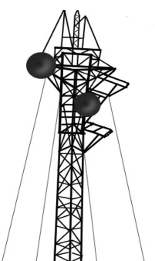
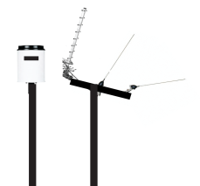
Terrestrial-based solutions: Interrogated Radio
Concept
  Bi-directional communication system
  Very similar to the SCADA without the implied control of SCADA
  Data is usually collected by developing a polling cycle for all stations in the network
    If the network is large, the amount of time for the polling cycle can be long
Frequencies: Usually in the VHF range being less than 180 MHz.
Regulation: The Telecom Regulatory Authority of India will need to provide permission to use radio frequencies.
Internet
Decision Support Center

Slide 8
Advantages/Disadvantages of Interrogated Radio
Advantages
  The radio frequencies are not shared with the public, which means during emergencies the public can not interfere with data collection
Disadvantages
  Radio licensing fees are expensive in India
  Higher maintenance cost

Slide 9
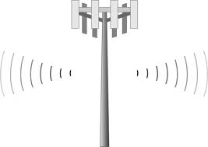
Terrestrial-based solutions: GSM/GPRS
Concept
  GSM/GPRS systems can work by sending text messages and/or data files
  Allows two-way communication, with the ability to change program settings, download data, or just query for the most recent measurements.
Internet
Decision Support Center

Slide 10
GSM/GPRS General Information
Transmission:
  900 MHz and 1.8GHz
Regulation:
  Open for public use. Just need service agreement with mobile network provider
The Coverage
  Makes GSM telecommunication a popular choice though there are several very important factors a hydrologic system operator must consider when choosing a telecommunication medium to relay hydrologic data
    GSM/GPRS network is shared with the public
    Real-time hydrologic systems that can miss periods of data collection, such as ground water, measurement, which is fairly static over time, are more suitable candidates to employ GSM/GPRS based technology
GSM Coverage in India
(taken from GSM World Coverage 2009)

Slide 11
Advantages/Disadvantages of GSM/GPRS
Advantages
  Coverage widely available in India
  Quickest technology to implement, requiring only a service agreement with the mobile network provider
  Relatively inexpensive
Disadvantages
  Unreliable for public safety requirements such as flood warning and emergency management (Mobile network is a “best effort” technology)
    Likelihood is great that the GSM/GPRS bandwidth could be consumed by the public during public emergency. The operational characteristics and policy of repair during outages must be well understood between the agency in charge of the network and the mobile network provider
    Can have high latency, especially Text Messaging
  Repairs controlled by network provider

Slide 12
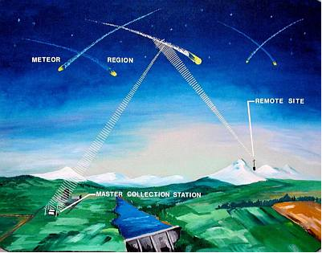
METEOBURST Radio
Concept
  METEOBURST is somewhat between a terrestrial and satellite radio system
  The METEOBURST technology relies upon the reflection of radio waves off of the ionosphere
  The transmitting station sends a radio signal to the upper atmosphere and the data is collected by a ground receive station
  The ground receive stations are often operated by a company that the customer would pay to collect and relay the signals back to the customer by way of the INTERNET

Slide 13
METEOBURST General Information
METEORBURST requires Master Collection Stations, which are run on a fee basis
Customers can acquire their own collection stations, but these collection stations are very expensive
  This is a good alternative to very remote operating stations where INSAT is otherwise unfeasible
The maximum range between transmitter and the Master Collection stations is approximately 1800 km, which has a maximum range second to only INSAT
The main use of METEORBURST is for extremely remote locations
It is used a great deal for remote snowpack measurements

Slide 14
Advantages/Disadvantages of METEOBURST
Advantages
  Is suitable for remote locations (similar to INSAT)
Disadvantages
  There are a very limited number of companies that provide METEORBURST capabilities, and there is only one actual manufacturer of the radio
  Large Antenna
  High Power Requirement
  May have high latency
  Uses the Internet for collection of data from regional master station

Slide 15
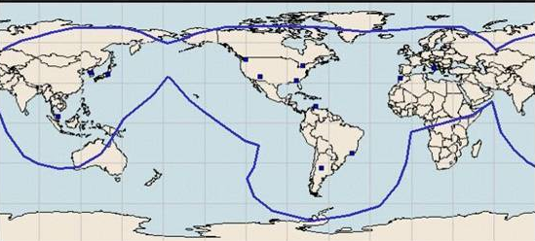
Satellite-based solutions: ORBCOMM
Concept
  ORBCOMM is a fee based satellite system that is capable of providing communication in very remote areas
  ORBCOMM incorporate LEO satellite configurations, while to provide near global coverage.
    ORBCOMM uses 36 satellites
  These satellites often support bi-directional communication, though bi-directional communication is not generally a requirement of hydrometric monitoring stations

Slide 16
Advantages/Disadvantages of ORBCOMM
Advantages
  The strength of these technologies is the capability to provide communication in very remote areas, where even geostationary satellites like INSAT do not provide coverage
  The radios to communicate with these systems are provided by several hydrometric equipment vendors
Disadvantages
  The high cost of this fee based service make this technology prohibitive, especially when a system like INSAT can deliver this same information at relative little cost to the user

Slide 17
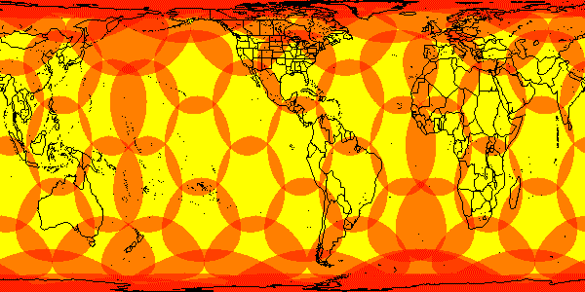
Satellite-based solutions: Iridium
Concept
  Iridium is a fee based satellite system that is capable of providing communication in very remote areas
  IRIDIUM incorporate LEO satellite configurations, to provide near global coverage
    IRIDIUM uses a constellation of 66 satellites
    Each satellite footprint is approximately 4500 km and all satellite footprints overlap
    One Commercial gateway in Tempe, Arizona USA
  These satellites often support bi-directional communication, though bi-directional communication is not generally a requirement of hydrometric monitoring stations

Slide 18
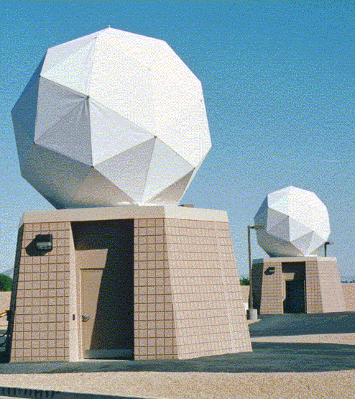
Advantages/Disadvantages of Iridium
Advantages
  The strength of these technologies is the capability to provide communication in very remote areas, where even geostationary satellites like INSAT do not provide coverage
  The radios to communicate with these systems are provided by several hydrometric equipment vendors
Disadvantages
  The cost of these fee based service make this technology prohibitive, especially when a system like INSAT can deliver this same information at relative little cost to the user (except for licensing fees)
  Data Collection over the Internet, or other multiple hop solutions

Slide 19
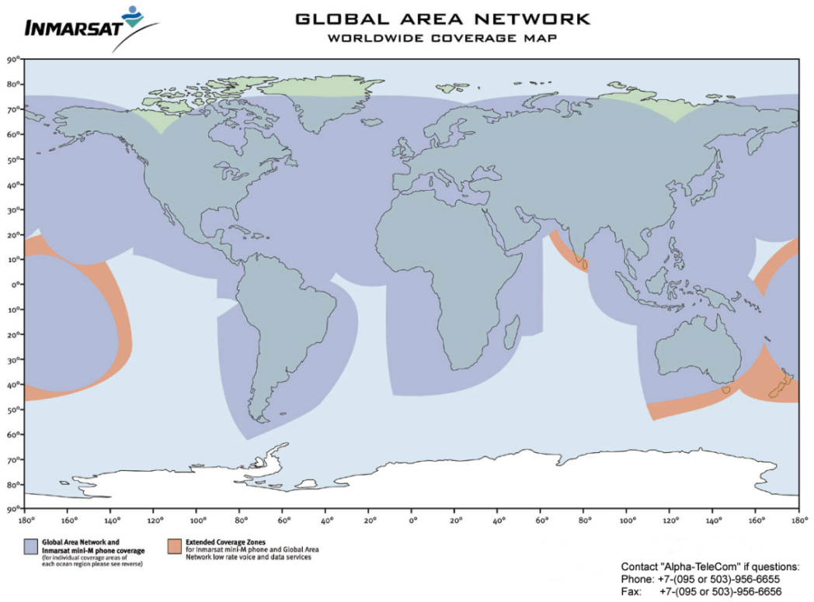
Satellite-based solutions: INMARSAT
Concept
  INMARSAT is a fee based satellite system that is capable of providing communication in very remote areas
  INMARSAT is based on an array of 4 geostationary satellites that are located above the equator at various locations around the world
  These satellites often support bi-directional communication, though bi-directional communication is not generally a requirement of hydrometric monitoring stations

Slide 20
Advantages/Disadvantages of INMARSAT
Advantages
  The radios to communicate with these systems are provided by several hydrometric equipment vendors
  Direct communications possible (minimal points of failure)
Disadvantages
  The high cost of these fee based service make this technology prohibitive, especially when a system like INSAT can deliver this same information at relative little cost to the user

Slide 21
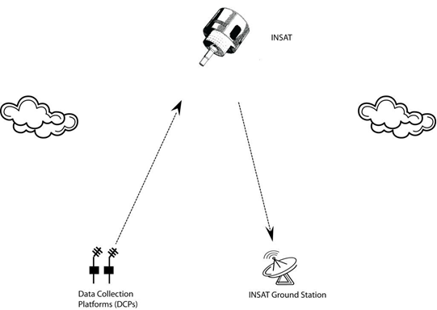
Satellite-based solutions: INSAT
Concept
  Operated by the government of India to provide support to real-time environmental monitoring
  Well suited for remote hydrometric data collection as well as data sharing. Data sharing is implicit in the method that INSAT employs to collect and relay data
    Anyone in view of the satellite can collect all hydrometric data, including data collected by IMD and CWC, who recently have been modernizing their networks with capabilities of real-time data collection

Slide 22
Advantages/Disadvantages of INSAT
Advantages
  One of the great advantages of INSAT is that communication is possible from virtually anywhere in India
  Satellite is not affected by local weather events that can often disrupt terrestrial-based communications, such as GSM/GPRS.
  High reliability and implicit data sharing
  Operates on very low power
Disadvantages
  India radio licensing is fees are onerous
  One way communication
  Radios are more expensive
  Requires a ground station

Slide 23
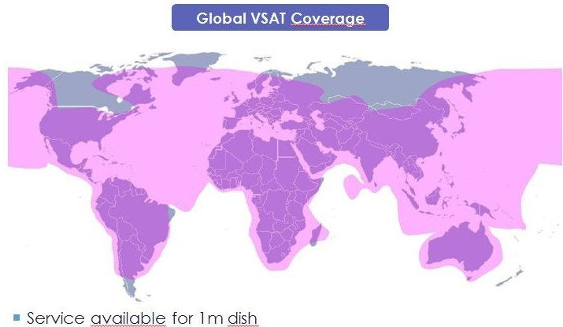
Satellite-based solutions: VSAT
Concept
  Privatively owned companies
  Bi-directional communication
  Complete Internet Solution (through satellite)
  Direct communication, though in some cases ground hops may exist (this is a point of failure)
  Well suited for SCADA, which requires bi-directional communication

Slide 24
Advantages/Disadvantages of VSAT
Advantages
  High reliability (if using Direct Connection)
  Bi-directional communication suitable for SCADA and interaction with data station (reprogramming)
  Radio licensing fees assumed by VSAT provider
  Used by banks and other institutions that require high availability
Disadvantages
  Large antenna/dish
  Uses more power than one-way devices
  High recurring cost (though this can be minimized with proper integration)

Slide 25
Factors in Deciding a Best Fit in Data Communication
Factors
  Availability
  Cooperation and Economy of Scale
  Cost (initial purchase)
  Recurring cost (Use Fee)
  Data Distribution
  Latency
  Maintenance
  Privacy
  Sustainability

Slide 26
Factors: Availability
Ensures a certain degree of operational continuity over a given period.
Disruptions of the data stream lead to loss of data
Measured as a percentage of time the system can be expected to operate over a given amount of time
High availability solutions include:
  Satellite-based relay systems, such as INSAT
Low availability solution include:
  GSM/GPRS
Additional Notes:
  There is an increased cost to achieve increasing availability.
  Higher system availability can also be achieved by providing backup communications.
  Some users, such as those that have a public safety mission, usually have requirements for the highest availability.
 | Availability
ALERT | High
GSM/GPRS | Medium
INSAT | High
Interrogated Radio | High
METEOBURST | Medium
ORBCOMM | Medium
INMARSAT | Medium
Iridium | Medium
VSAT | High

Slide 27
Factors: Cooperation and Economy of Scale
If there are cooperators that are using a given technology, this may sway the user to also employ same technology
Rather than replicating networks, various agencies can use each others network and save significant resources
In addition, with multiple cooperators sharing a given technology means that there is a built-in support system amongst the users of the data
 | Cooperation & EC
ALERT | Low
GSM/GPRS | Medium
INSAT | High
Interrogated Radio | Low
METEOBURST | Low
ORBCOMM | Low
INMARSAT | Low
Iridium | Low
VSAT | Medium

Slide 28
Factors: Cost (Initial Purchase)
The initial cost of the installation of a real-time data collection system can vary greatly by solution
Low cost system:
  Mobile phone network (GSM/GPRS)
High cost system:
  Terrestrial radio systems in mountainous terrain where numerous communication towers need to be put in place
  INSAT, if the user must purchase an INSAT ground station, which can be in excess of 5,000,000 INR
 | Cost (Initial)
ALERT | High
GSM/GPRS | Low
INSAT | Medium
Interrogated Radio | High
METEOBURST | Low
ORBCOMM | Low
INMARSAT | Low
Iridium | Low
VSAT | Low

Slide 29
Factors: Recurring Cost (Use Fee)
There is an initial cost to installing equipment, and a recurring cost of operating the equipment
Some solutions have user fees, while others do not
  Mobile phone network users must pay for the use of the network
  Changing telecommunication methods after the initial installation of equipment can be great, so it is incumbent upon the user to consider recurring fees and the uncertainty of the cost of the technology in the future
 | Recurring Cost
ALERT | Low
GSM/GPRS | Medium
INSAT | Low
Interrogated Radio | Low
METEOBURST | High
ORBCOMM | High
INMARSAT | High
Iridium | High
VSAT | Medium

Slide 30
Factors: Data Distribution
It is often an advantage to employ a real-time data relay system that inherently provides data distribution through the method it uses to provide data relay
Good Data Distribution:
  INSAT, where data from all users is transmitted from space to all points in India. All one needs is a satellite ground station
Difficult Data Distribution:
  Terrestrial based radio system, and GSM/GPRS
 | Data Distribution
ALERT | Low
GSM/GPRS | Medium
INSAT | High
Interrogated Radio | Low
METEOBURST | Low
ORBCOMM | Low
INMARSAT | Low
Iridium | Low
VSAT | Medium

Slide 31
Factors: Latency
Latency in hydrometric data systems has to do with the delay from the time the data is measured to the time it is received by the user
Institutions that have a public safety mission generally require the least latency, as increased latency reduces the lead time to react to a given situation
Institutions that are tasked to monitor flash floods, tsunami, or other natural threats to the population and industry are examples of systems that require low latency
Most hydrometric data relay solutions have very little delay from the time of data collection to reception by the user
 | Latency
ALERT | Low
GSM/GPRS | Low
INSAT | Low
Interrogated Radio | Low
METEOBURST | Medium
ORBCOMM | Low
INMARSAT | Low
Iridium | Low
VSAT | Low

Slide 32
Factors: Maintenance
Some hydrometric systems have greater exposure to substantial maintenance issues
High Maintenance
  Terrestrial radio system that relies upon a series of radio towers where equipment is mounted to help relay data
Low Maintenance
  GSM/GPRS and the INSAT data collection system
 | Maintenance
ALERT | Medium
GSM/GPRS | Low
INSAT | Low
Interrogated Radio | Medium
METEOBURST | Low
ORBCOMM | Low
INMARSAT | Low
Iridium | Low
VSAT | Low

Slide 33
Factors: Privacy
In some instances the monitoring agency may want to keep hydrometric information private
  This is not typically the case of most agencies operating hydrometric systems, as data is shared to avoid duplication of effort
High Privacy
  Fee service such as Iridium or INMARSAT
Low Privacy
  INSAT
 | Privacy
ALERT | High
GSM/GPRS | High
INSAT | Low
Interrogated Radio | High
METEOBURST | High
ORBCOMM | High
INMARSAT | High
Iridium | High
VSAT | High

Slide 34
Factors: Sustainability
Complexity of the solution that is being utilized.
  If a given user is the only one using a certain technology, then the challenges for sustained operations are more of a challenge.
  If real-time telemetry solution is shared among many cooperating agencies, then this leads to a much greater chance of sustainability.
  Control a user has over the technological solution being used can lead to greater sustainability
  Low Sustainability
    Iridium and Orbcomm
  Highly sustainable solutions
    ALERT is mostly under the control of the user. This generally leads to a more sustainable solution.
    INSAT is also a highly sustainable solution because of the commitment of IMD to fund this important component of the INSAT services.
 | Sustainability
ALERT | High
GSM/GPRS | Medium
INSAT | High
Interrogated Radio | Low
METEOBURST | Low
ORBCOMM | Low
INMARSAT | Low
Iridium | Low
VSAT | Medium

Slide 35
Factors: Comparison
 | ALERT | GSM/GPRS | INSAT | Interrogated Radio | METEORBURST | ORBCOMM, INMARSAT, IRIDIUM | VSAT
Availability | High | Medium | High | High | Medium | Medium | High
Cooperation & EC | Low | Medium | High | Low | Low | Low | Medium
Cost (Initial) | Low | Low | Medium | Low | Low | Low | Low
Data Distribution | Medium | Medium | High | Low | Medium | Medium | Medium
Latency | Low | Low | Low | Low | Medium | Low | Low
Maintenance | Medium | Low | Low | High | High | High | Low
Privacy | High | High | Low | High | High | High | High
Recurring Cost | Low | Medium | Low | Low | High | High | Medium
Sustainability | High | Medium | High | Low | Low | Low | Medium

Slide 36
Which telemetry solution provides higher reliability?
✓
✓
✗
✓
✗
a. VSAT
b. INSAT
c. Mobile phone network (GSM/GPRS)
d. Terrestrial Radio (ALERT)
e. Meteorburst

Slide 37
Which telemetry systems are greater in cost?
✓
✓
✗
✓
✓
a. VSAT
b. INSAT
c. Mobile phone network (GSM/GPRS)
d. Meteorburst
e. Iridium

Slide 38
End of Module 2: Part 2

